Slide 1
Coronary Artery Disease Prediction Using Classification Algorithms
Ryerson University CKME 136 Capstone Presentation
Todd Bethell
July 30, 2019

Slide 2
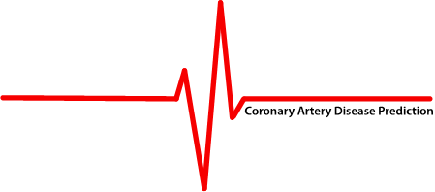
Dataset Overview
The dataset used in this project is called the ‘Z-Alizadeh Sani dataset’ and includes 52 variables collected from 303 random visitors to Tehran’s Shaheed Rajaei Cardiovascular, Medical and Research Center who were suspected of having Coronary Artery Disease (CAD).
Angiography was used to determine that 87 patients were healthy (normal) and 216 had CAD.
Angiography is considered an accurate method used to diagnose the presence of CAD. However, it is an expensive procedure and there are many risks and potential side-effects of angiograms. As such, a more cost-effective and less invasive method is needed in order to make accurate diagnoses of CAD.
1

Slide 3
Algorithms Used
This project will assess the predictive capability for Coronary Artery Disease (CAD) using three different types of classification machine learning algorithms:
Random Forest Algorithm: Builds multiple ‘decision trees’ and merges them together to get a more accurate and stable prediction. (Decision Trees are constructed by repeatedly splitting feature space into smaller and smaller subsets – while at the same time a ‘tree’ (with decision nodes and leaf nodes) is incrementally developed. Decision nodes have two or more branches. Leaf nodes represent a classification or a decision. The topmost decision node corresponds to the best predictor, called the ‘root node’.
Naïve Bayes Algorithm: A classification algorithm based on ‘Bayes Theorem’ (calculating the probability of an event based on its association with another event). It considers that each of the independent features contribute independently to the probability that the patient has CAD or not, regardless of any correlations between features. This is why it is labelled “naïve”.
Logistic Regression Algorithm: Estimates the probability of an event occurring given some previous data. It works with binary data (where either an even happens or does not). While ‘linear regression’ tries to predict data by finding a linear – straight line – equation to predict future data points, logistic regression uses the natural logarithmic function to find the relationship between the variables and uses test data to find the coefficients. The function can then predict future results using these coefficients on the logistic equation.
2

Slide 4
Overview of the 52 Attributes
Demographic Attributes
1
15 variables such as age, gender, obese or not, smoker or not.
Symptom and Examination Attributes
2
13 variables such as blood pressure, shortness of breath, chest pain.
Electrocardiogram (ECG) Attributes
3
7 variables such as whether there is left ventricular hypertrophy or a bundle branch block.
Laboratory and Echocardiographic Attributes:
4
17 variables such as fasting blood sugar, white blood cell count, HDL and LDL levels.
3

Slide 5
Demographic Attributes
4

Slide 6
Symptom & Examination Attributes
5

Slide 7
Electrocardiogram Attributes
6

Slide 8
Laboratory & Echocardiographic Attributes
7

Slide 9
Discretized Features & Their Range of Values
8

Slide 10
Class Imbalanced
Data Set
71%
Angiography tests resulted in 71% of the study patients being diagnosed with Coronary Artery Disease (CAD)
29%
Versus 29% who were found to be ‘Normal’
9

Slide 11
Initial Data Analysis
3 Variables Removed
There was originally 55 variables in the data set (besides the response variable). ‘Length’ (or ‘height’) and ‘BMI’ were removed because this data is captured in the ‘Obesity’ variable. That is, BMI is calculated using height and weight - and ‘Length’ and ‘BMI’ were not further discretized in the original study, but ‘Obesity’ was (such that a BMI score higher than 25 is considered ‘obese’ in the data set used. ‘Exertional Chest Pain’ was removed because there was no variation in this attribute – that is, every response was the same (‘No’). As such, there would be no benefit to including this attribute.
Missing Data
Confirmed that there was no missing data in the data set.
Errors in Data
Confirmed that there were no errors, duplicates and/or incomplete or inappropriate entries.
10

Slide 12
Data Type Descriptions
Original Data Types in Dataset
32 of the 52 variables were ‘numeric’ or ‘integer’ data types. The rest were originally ‘factor’ (categorical) data types.
Converted to Factor Data Types
After univariate analysis, the 32 numeric and integer data types were converted to factor data types.
Discretized Some Variables
19 variables were discretized according to the ranges and descriptions provided in the original medical study. 2 variables were discretized per accepted medical literature.
Converted Some Variables to ‘Ordered Factor’
Factor data types that had a meaningful order, such as ‘low’, ‘medium’ and ‘high’, were converted to ‘ordered factor’ variables.
The Response Variable
The output (response) variable is ‘CAD’ or ‘Normal’, to show whether the patient has Coronary Artery Disease or not.
11

Slide 13
Pearson Correlation
of Continuous Variables
Only Neutrophil and Lymphocyte attributes have a strong (negative) correlation.
With regards to this inverse relationship, an abnormal increase in one kind of white blood cell can cause a decrease in another kind. Both abnormal results can be due to the same underlying condition.
Later analysis shows that these two variables are not significant for CAD prediction.
12

Slide 14
Tests of Normality
Shapiro-Wilk Test of Normality
The null hypothesis of this test is that the population is normally distributed. If the p-value of this test is less than the chosen alpha level (0.05 in this case), then the null hypothesis is rejected. As such, p-values below 0.05 mean that the data for the variable in question is not normally distributed.
The p-value results on the right show that none of the variables with continuous data types are normally distributed. These tests were completed before these variables were discretized.
13

Slide 15
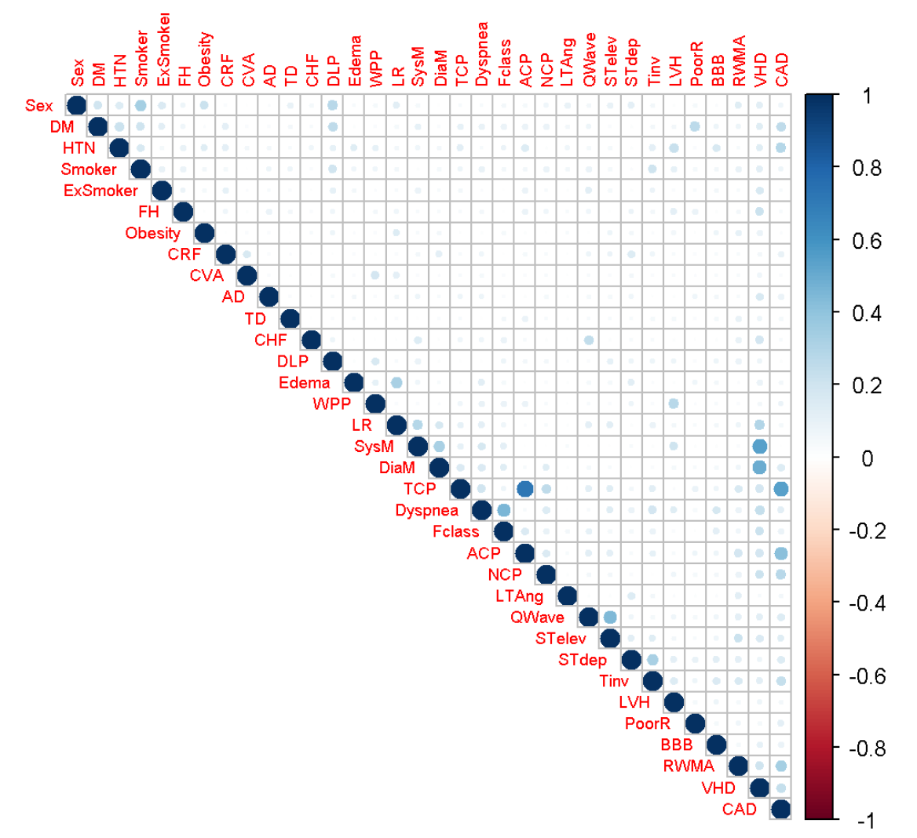
Measures of Association
Between Factor Variables
Measures of association were measured using Cramér’s V calculations – which provides a number that ranges between 0 and 1. It indicates how strongly two categorical (factor) variables are associated. The measurements show a ‘small’ association when the result is between 0.10 and 0.30; ‘medium’ between 0.30 and 0.50; and ‘large’ when over 0.50
The highest result was 0.715 and was found between TCP (Typical Chest Pain) and ACP (Atypical Chest Pain). This relationship will be reviewed later. The second highest measure of association was 0.544 between SysM (Systolic Murmur) and VHD (Vascular Heart Disease). The next highest result of 0.535 was between TCP and CAD (Coronary Artery Disease – that is, the response variable). Lastly was the result of 0.498 between DiaM (Diastolic Murmur) and VHD. All of the rest of the variables showed small or medium associations.
14

Slide 16
Feature Selection
Method 1
Method 2
Method 3
Used the ‘FSelector’ package in R.
This is a feature ranking technique that ranks the top features according to a user-defined filter. I used an ‘entropy-based’ filter (that is, ‘information gain’ to rank the top 10 features.
The results were as follows: TCP; ACP; RWMA; EF; HTN; Age; DM; NCP; Tinv and FBS.
Used the ‘FSelectorRccp’ package in R.
This function also ranks the top features using the information-gain entropy-based filter. Again, it was set up to select the top 10 features.
The results were as follows: TCP; ACP; RWMA; EF; HTN; Age; DM; NCP; Tinv and FBS.
Therefore, the results of FSelector and FSelectorRccp were identical.
Used the ‘Recursive Feature Elimination’ function, as part of the ‘Caret’ package in R.
Ranks the features using one of a number of pre-defined functions. I used the ‘rfFuncs’ (random forests) function, given that we are working with ‘non-linear’ models. As such, it is another entropy-based filter method. There was significant improvement in the accuracy of the results between 4 and 8 variable subgroups, but negligible improvement between 8 and 16 – so 8 features were chosen.
Results were the same top 8 as the other methods: TCP; EF; RWMA; NCP; ACP; HTN; Age and DM.
15

Slide 17
8 Most Important Variables
Not in any order (Variables 1 to 4):
1
2
3
4
TCP: Typical (Classic) Angina Chest Pain
ACP: Atypical (Probable) Angina Chest Pain
NCP: Non-Anginal Chest Pain
HTN: History of Hypertension
¹ Substernal pain (behind the sternum bone) ² provoked by exertion or emotional stress – and ³ relieved by rest or nitroglycerine (or both).
Applies when two out of the three criteria of classic angina (TCP) are present. (Angina is chest pain caused by reduced blood flow to the heart).
If only one (or none) of the three criteria of classic angina (TCP) are present.
Having a history of high blood pressure.
16

Slide 18
8 Most Important Variables
Not in any order (Variables 4 to 8):
5
6
7
8
RWMA: Regional Wall Motion Abnormality
EF: Ejection Fraction
DM: History of Diabetes Mellitus
Age
The motion of a region of the heart muscle is abnormal – diagnosed with an echocardiography (ultrasound imaging of the heart).
A measurement of the percentage of blood leaving the heart each time it contracts.
A disease in which the body’s ability to produce or respond to the hormone insulin is impaired.
Men ≤ the age of 45 and/or women ≤ the age of 55 versus men > 45 and/or women > 55.
17

Slide 19
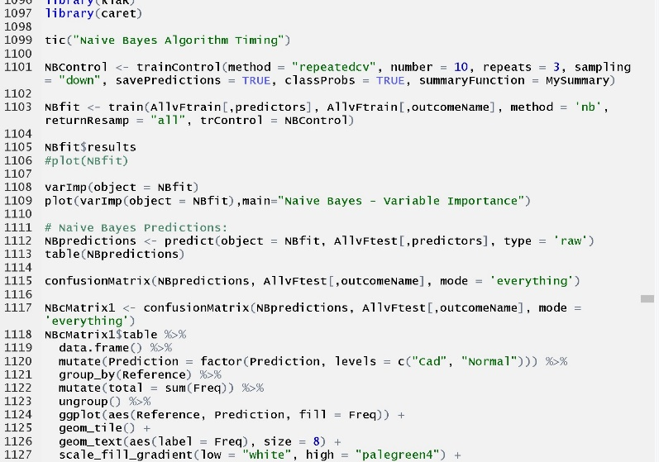
Algorithm Steps
1
Select top 8 features to use for prediction of ‘CAD’ or ‘Normal’. Used FSelector, FSelectorRccp and Recursive Feature Elimination (Caret) to select the top 8 attributes.
2
Use ‘createDataPartition’ function to split data set into training and test sets (75/25) - to ensure that the distribution of outcome variable classes will be similar in both sets.
3
Train the model (Random Forest; Naïve Bayes; Logistic Regression) using the train data set. Configured a 10-fold cross validation for the training set.
To address the class imbalance, use one of two methods: ‘SMOTE’ and ‘DOWN’ . SMOTE (Synthetic Minority Over-Sampling Technique) was used for Logistic Regression training and Undersampling (DOWN) of the majority class was done for the other algorithms
4
5
Use the trained model to predict on the test data set.
Use the Confusion Matrix results to evaluate the quality of the predictions. Evaluate using accuracy, kappa, sensitivity, specificity, precision, F1-score & Matthew’s Correlation Coefficient
6
18

Slide 20
Algorithm Evaluation – Confusion Matrix Overview
19

Slide 21
Algorithm Evaluation – Confusion Matrix Calculations
20

Slide 22
Random Forest – Confusion Matrix Calculations
21

Slide 23
Random Forest Results
Accuracy
Kappa
Sensitivity
Specificity
Precision
F1 Score
.9067
.7782
.9074
.9048
.9608
.9333
Matthew’s Correlation Coefficient is a balanced measure of the quality of binary classification algorithms. It takes into account true and false positives and negatives. A score of ‘1.0’ is a perfect prediction, a ‘0’ is no better than random prediction and a ‘-1.0’ indicates total disagreement between prediction and observation.
Matthew’s Correlation Coefficient
.7817
22

Slide 24
Naïve Bayes – Confusion Matrix Calculations
23

Slide 25
Naïve Bayes Results
Accuracy
Kappa
Sensitivity
Specificity
Precision
F1 Score
.9200
.8072
.9259
.9048
.9615
.9434
Matthew’s Correlation Coefficient is a balanced measure of the quality of binary classification algorithms. It takes into account true and false positives and negatives. A score of ‘1.0’ is a perfect prediction, a ‘0’ is no better than random prediction and a ‘-1.0’ indicates total disagreement between prediction and observation.
Matthew’s Correlation Coefficient
.8088
24

Slide 26
Logistic Regression – Confusion Matrix Calculations
25

Slide 27
Logistic Regression Results
Accuracy
Kappa
Sensitivity
Specificity
Precision
F1 Score
.8933
.7375
.9804
.7083
.8772
.9345
Matthew’s Correlation Coefficient is a balanced measure of the quality of binary classification algorithms. It takes into account true and false positives and negatives. A score of ‘1.0’ is a perfect prediction, a ‘0’ is no better than random prediction and a ‘-1.0’ indicates total disagreement between prediction and observation.
Matthew’s Correlation Coefficient
.7522
26

Slide 28
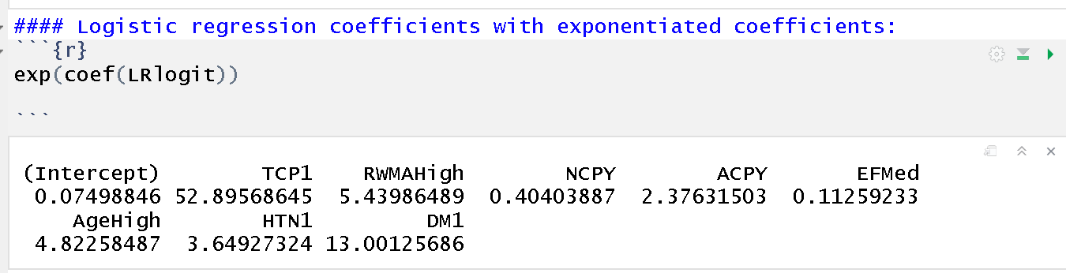
Interpretation of 8 Predictor Variables
To provide some assistance with the interpretation of the impact of the predictor variables – we can refer to the ‘exponentiated’ coefficients provided by the logistic regression algorithm.
When there is a one unit increase in ‘Ejection Fraction (medium)’ (EFMed - versus ‘low’ which is not normal) the odds for CAD is approximately 11% lower (since the logistic regression coefficient was -2.1840). Likewise, the odds of CAD when there is a one unit increase in Non-Anginal Chest Pain (NCPY) is approximately 40% lower than when NCP is not present (exponent of -.9062 coefficient).
The odds of having CAD increases by a factor of 52 times when there is a one unit increase in typical angina chest pain (TCP1) versus if there is no TCP present; increases a factor of 2.37 times for a one unit increase in Atypical Chest Pain (ACPY) being present, versus not being present; increases by a factor of 5.4 times for a one unit increase in RWMA being ‘high’ (versus not being present); increases by a factor of 4.8 times for a one unit increase in Age(high) versus Age ‘medium’; increases by a factor of 3.6 times with a one unit increase in Hypertension (HTN1) versus not being present; and increases by a factor of 13 times with a one unit increase in diabetes (DM1), versus not being present.
27

Slide 29
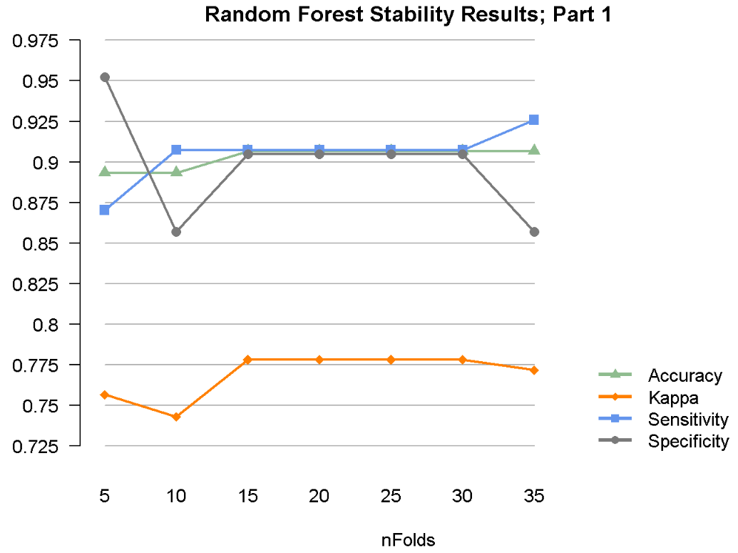
Random Forest Algorithm Stability
28

Slide 30
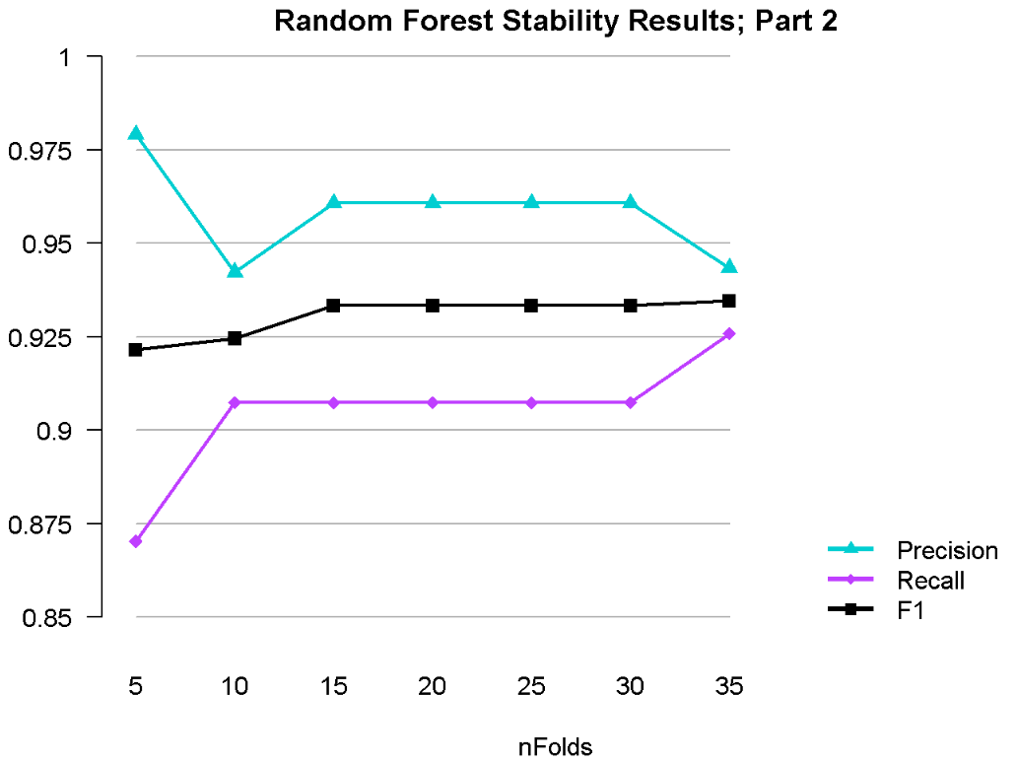
Random Forest Algorithm Stability - Continued
29

Slide 31
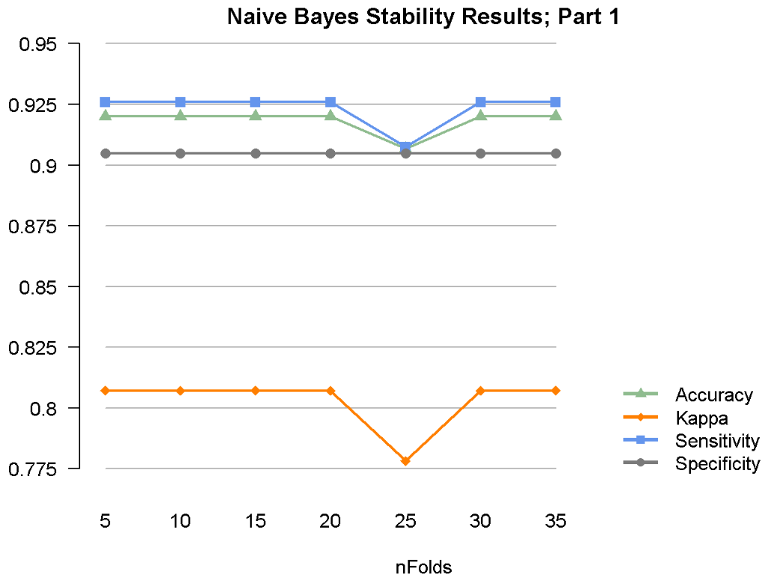
Naïve Bayes Algorithm Stability
30

Slide 32
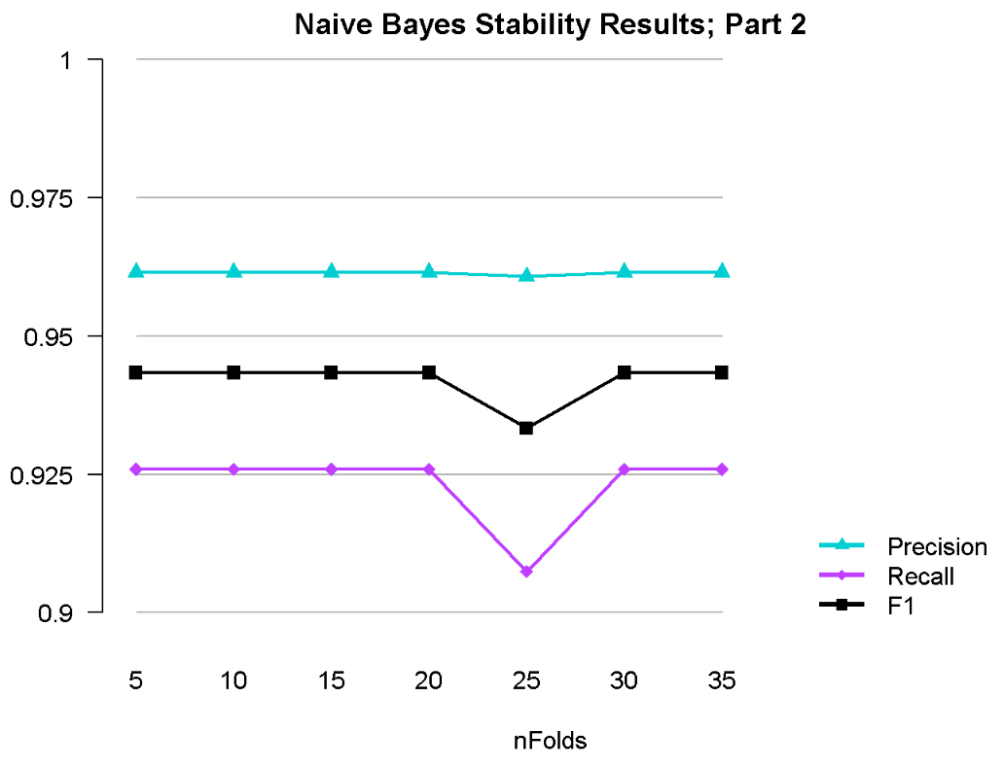
Naïve Bayes Algorithm Stability - Continued
31

Slide 33
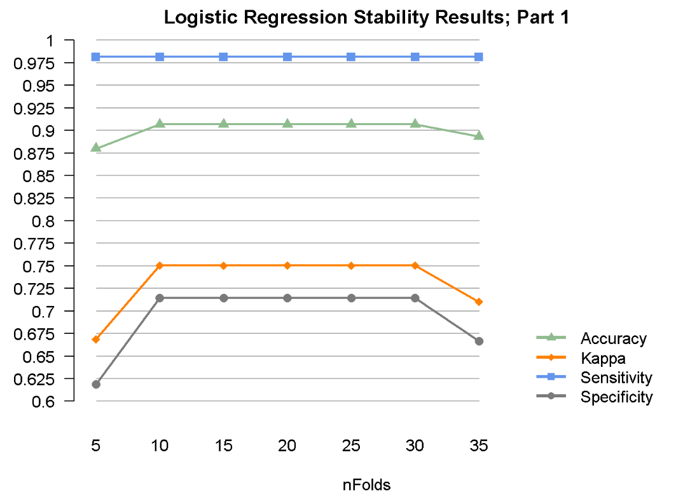
Logistic Regression Algorithm Stability
32

Slide 34
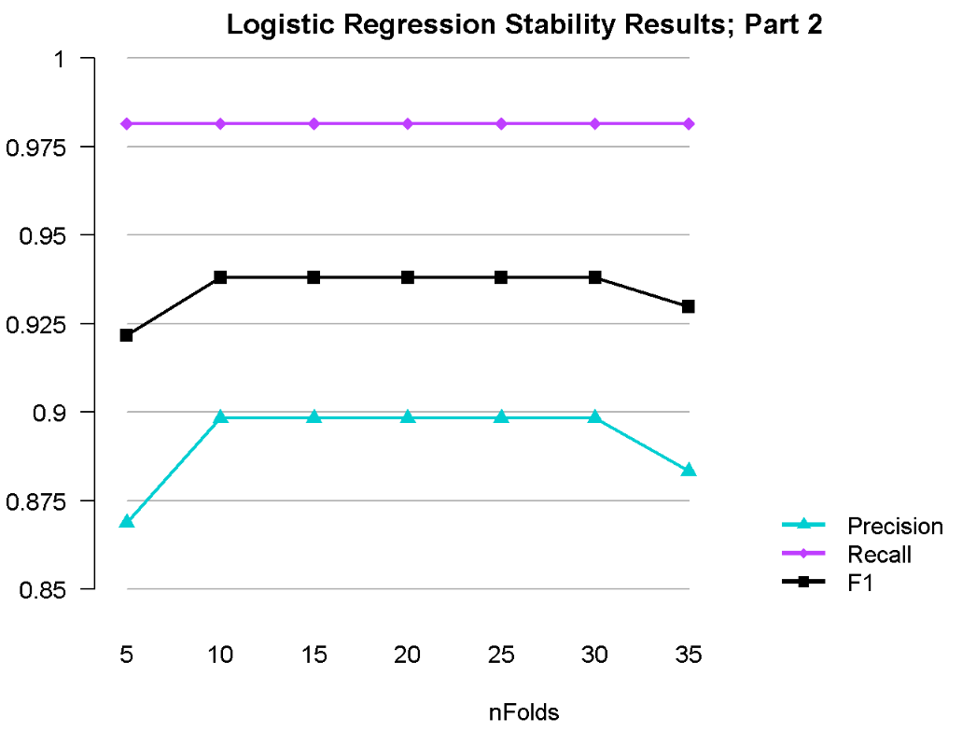
Logistic Regression Algorithm Stability - Continued
33

Slide 35
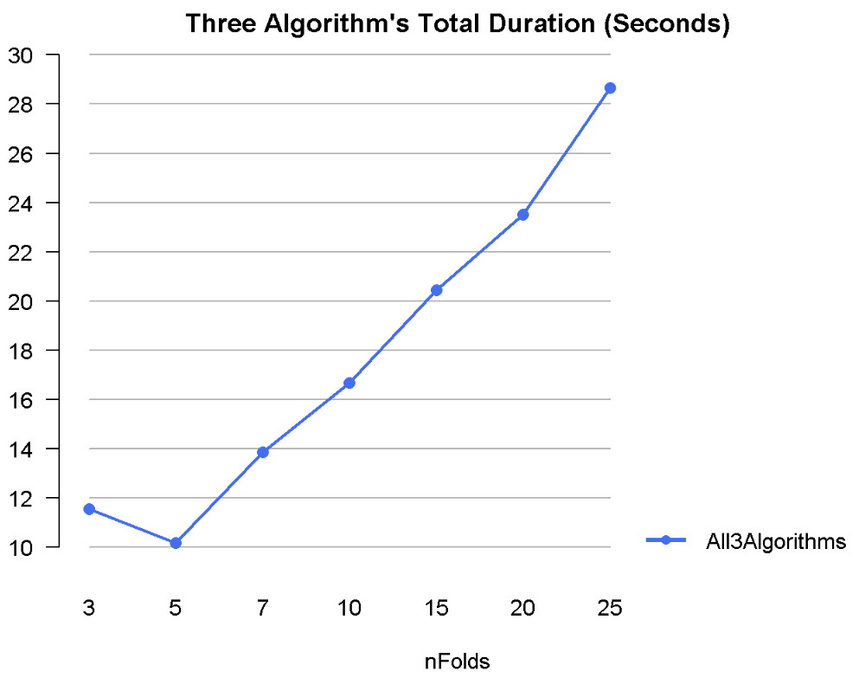
Algorithm Duration
34

Slide 36
Conclusions
Naïve Bayes is the Best Classifier Overall; Logistic Regression is Best for Sensitivity
The 8 features that were selected to be used with all three algorithms were sufficient to produce accurate predictions of Coronary Artery Disease (CAD). The final 8 features were as follows: Typical Angina Chest Pain (TCP), Atypical Angina Chest Pain (ACP), Non-anginal Chest Pain (NCP), history of Hypertension (HTN), Regional Wall Motion Abnormality (RWMA), Ejection Fraction (EF), history of Diabetes (DM), and Age.
Although all three algorithms were capable of predicting Coronary Artery Disease using these 8 attributes, Naïve Bayes provided the best results ‘overall’. Several evaluation measures, and in particular, the Matthew’s Correlation Coefficient, had results that were slightly better than the Random Forest and Logistic Regression algorithms.
However, given that this study involves a medical diagnosis, ‘Sensitivity’ becomes a crucial metric for evaluation. That is, being diagnosed as ‘Normal’ when CAD is present would obviously be a big concern. As such, Logistic Regression performed better consistently when Sensitivity is considered.
The objective of this study was to determine whether classification algorithms can be a viable alternative to angiography in order to get a less expensive and less invasive method of predicting Coronary Artery Disease. Rather than depending on angiography – or 55 attributes (including 17 demographic details, 13 examination results, an electrocardiogram test, 14 lab results from blood tests and an echocardiogram test) – good results were achieved using 8 variables. That is, 6 questions and 1 echocardiogram test.
35

Slide 37
Thank you

